Slide 1
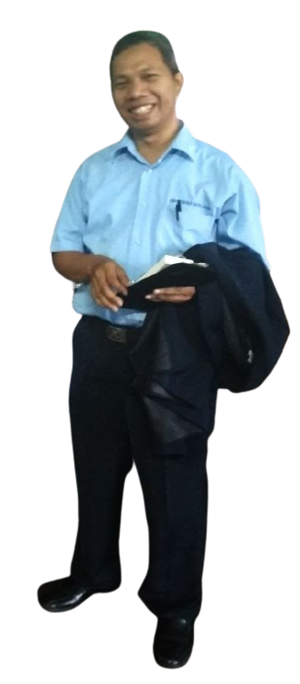
Tren Riset Bidang
Artificial
Intelligence

Slide 2
artificial intelligence
“the designing and building of intelligent agents that receive percepts from the environment and take actions that affect that environment”
Russel & Norvig, 2016 “Artificial Intelligence: A Modern Approach”

Slide 3
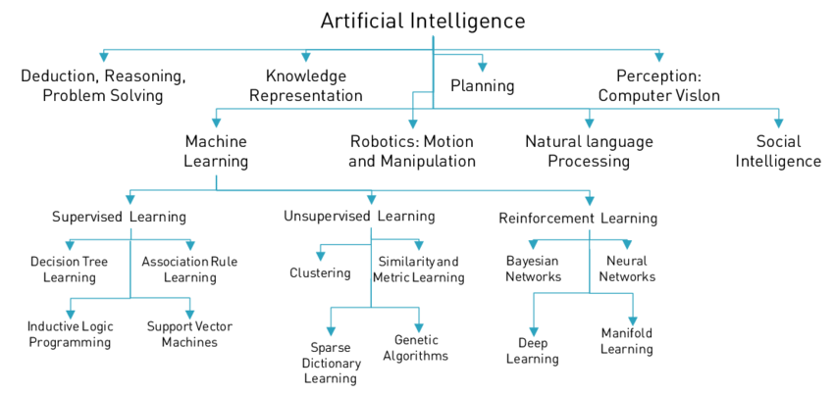
Notes:
Sumber: https://www.researchgate.net/figure/AN-OVerVieW-OF-NOTABLe-APPrOACHeS-AND-DiSCiPLiNeS-iN-Ai-AND-MACHiNe-LeArNiNg-101_fig5_316983844

Slide 4
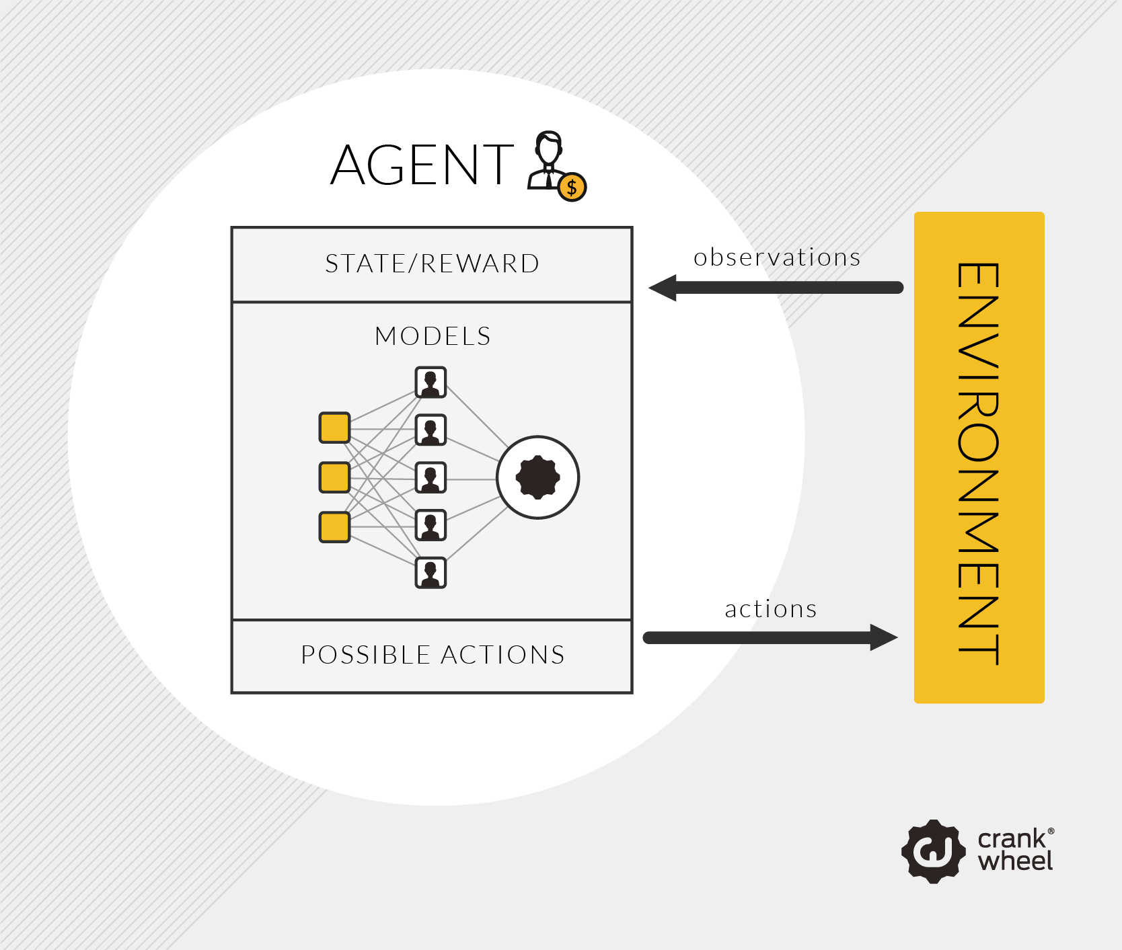
Cara Kerja AI

Slide 5
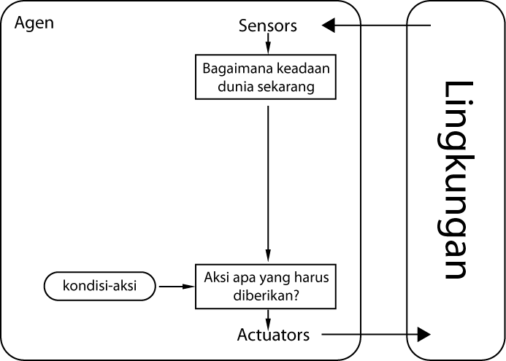
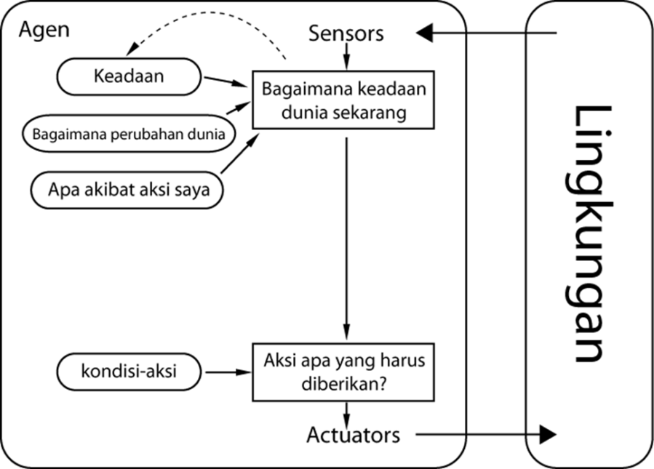
Agen Cerdas
Simple Reflex Agent
Model-based Reflex Agent

Slide 6
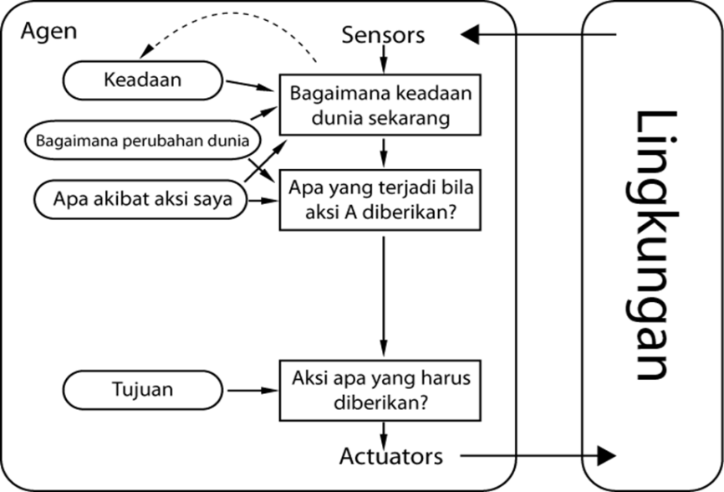
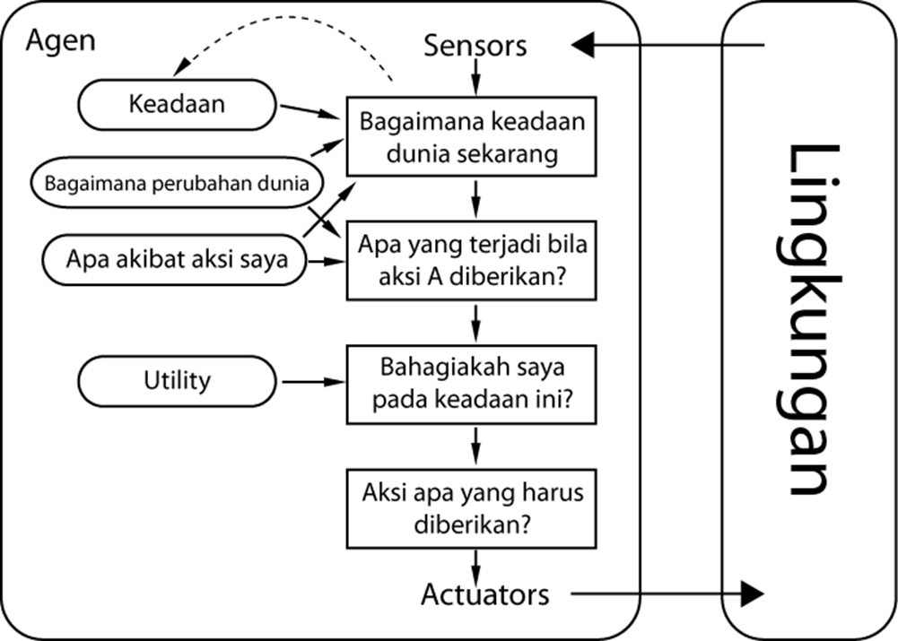
Agen Cerdas
Goal-based Reflex Agent
Utility-based Reflex Agent

Slide 7
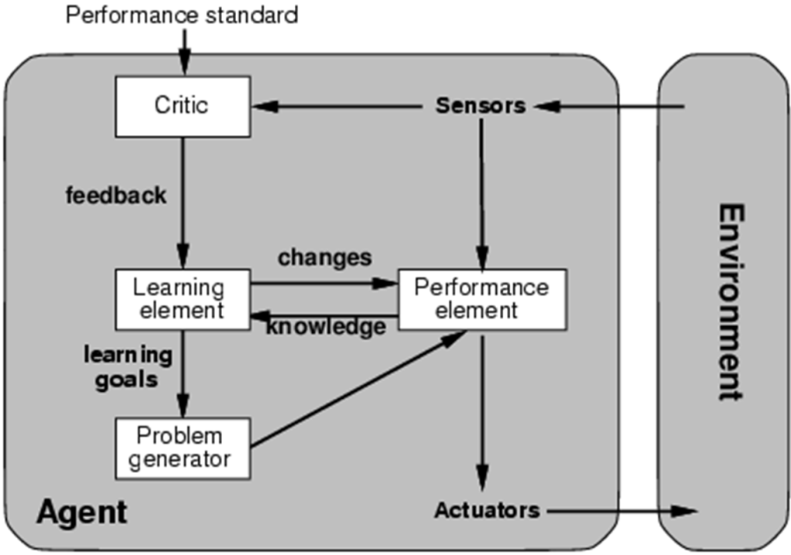
Agen Cerdas
Learning-based Reflex Agent

Slide 8
Pencarian
Blind search
Breadth First Search (BFS)
Depth First Search (DFS)
Heuristic search
Best First Search (BFS)
A*
Hill Climbing Search
Searching

Slide 9
Machine Learning
Supervised Learning
Decision Tree
Naïve Bayes
K-NN
Unsupervised Learning
Clustering: K-Means, K-Medoids, dll
Reinforcement Learning
Neural Network
Deep Learning

Slide 10
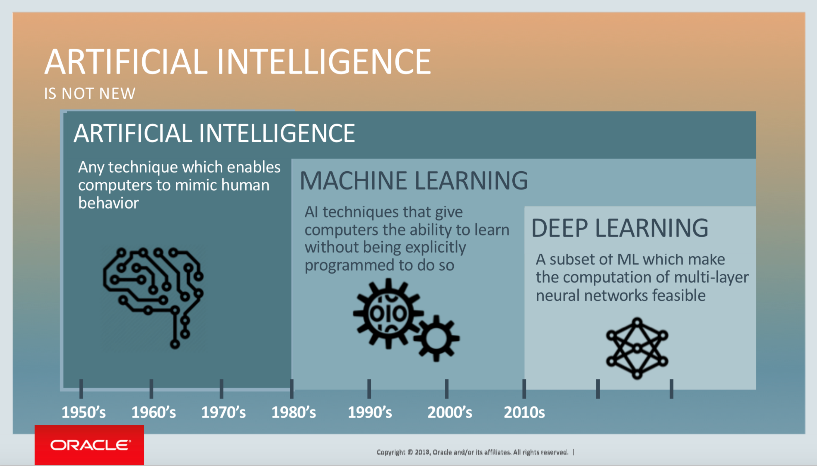
Deep Learning

Slide 11
computer vision ?
Computer vision is an interdisciplinary field that deals with how computers can be made to gain high-level understanding from digital images or videos. From the perspective of engineering, it seeks to automate tasks that the human visual system can do.
Notes:
Sumber: https://en.wikipedia.org/wiki/Computer_vision

Slide 12
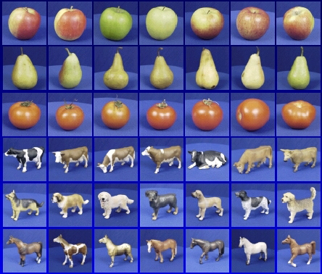

Pattern Recognition
Training
Training Labels
Training Images
Image Features
Training
Learned model
Learned model
Testing
Image Features
Prediction
Test Image
Slide credit: D. Hoiem

Slide 13
Aplikasi Kecerdasan Artifisial
Learning / Training / Pemodelan
Model / Rule
Data training
Dataset
Performance
AI System Deployment
Data testing

